Slide 1

SaveMe
Graphical Password Strategy Solution for user accounts
Marvin Vuu, Hamza Farhat, Minhal Syed

Slide 2
Table of Contents
Introduction
Objectives
Measure of Success
Risks
Activity Diagram & Gantt Chart

Slide 3
Introduction
Alphanumeric system fails to provide adequate security since they need to be complex and difficult to guess.
User authentication is a critical part in securing users to their accounts.
Solution is the graphical password. Allows for a set of images in a set order.

Slide 4
Objectives & Measures of Success

Slide 5
Objectives
Create a functional graphical password that only works with the correct images and sequence.
Display a set amount of images determined by the user
Let the user input their password correctly.
Allow users to upload their own images to set password.
Option of having a universal password for all accounts.

Slide 6
Measures of Success
The system has a working database that stores passwords and matches them to the correct users.
Security breaches, Bugs with the system rarely occur.
Customers give positive feedback, showing they are satisfied with the product.
The project deadline was reach and we did not exceed the budget.

Slide 7
Risks
Potential errors to occur and countermeasures

Slide 8
Risk 2 : The time needed for each activity was underestimated.
Deadline for each subtask within activity allows for control
Risk 1: Customer is not satisfied with the final product.
Create prototypes
Risk 4: Workload is too heavy for employees.
Allocate resources properly with throughout project
Risk 3: Requirements change during the development phase.
Incremental development while holding stakeholder meetings.

Slide 9
Activity Diagram & Gantt Chart
A list of activities followed for this project duration as well as Tasks planned

Slide 10
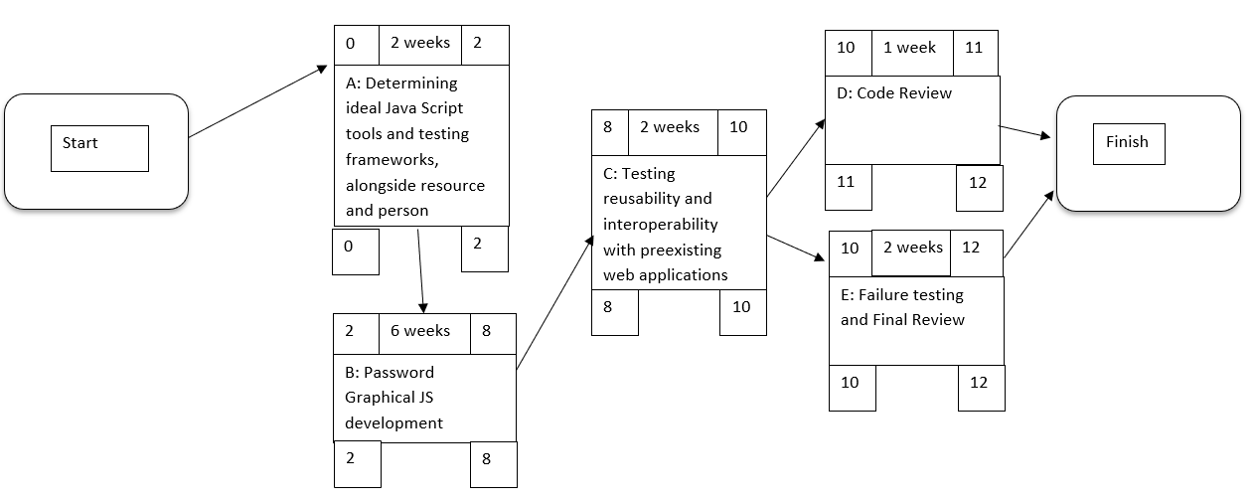
Activity Diagram

Slide 11
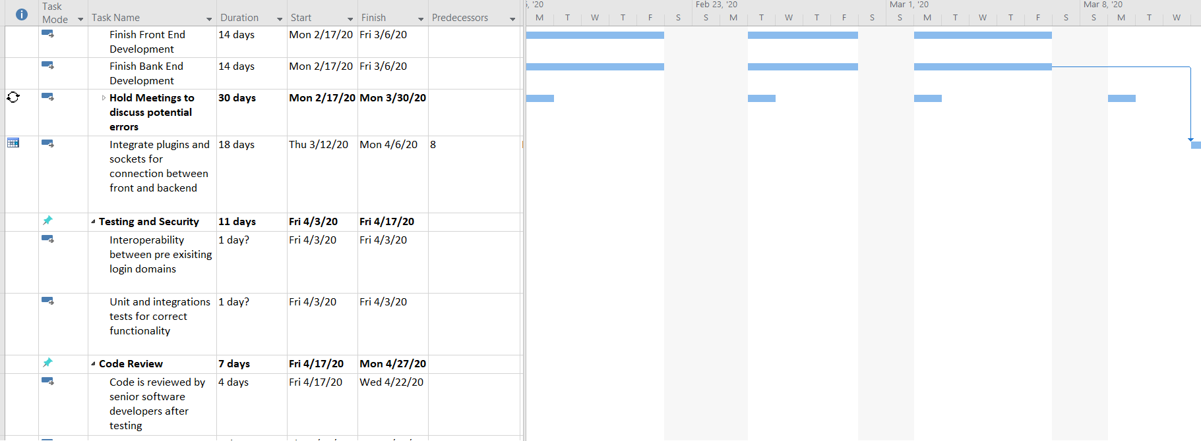
Gantt Chart

